Slide 1
Website recon
Pat walton

Slide 2
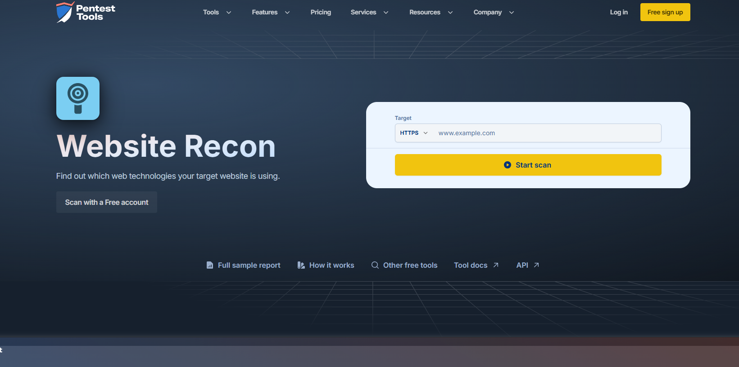
Start page
This is the start page for the website recon which has many tools to use it.
When you put in a website, it will scan it for malware or viruses.

Slide 3
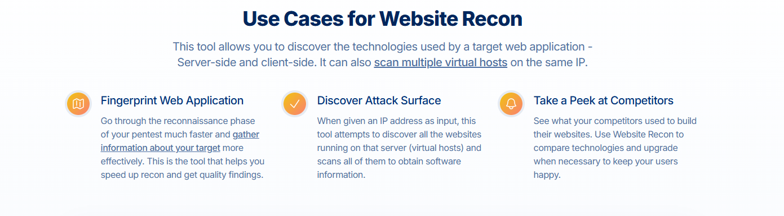
How it works
These are how it works in the websites. Using fingerprint web application and use hosts to find IP addresses.

Slide 4
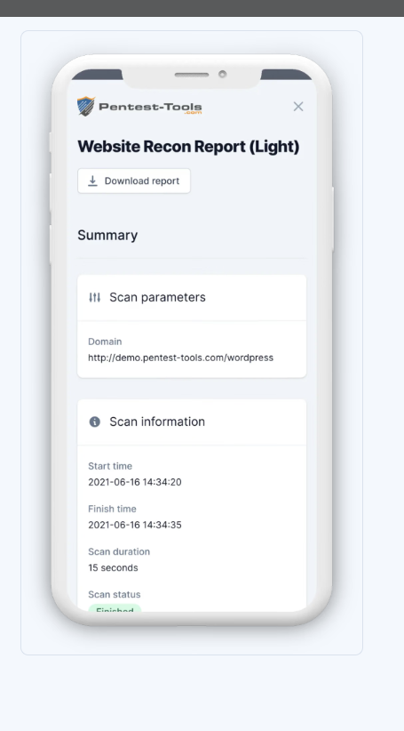
Example
Example of what it looks like
(a full report)
Allows you to download and even
Shows domain and tells you how long
It took.

